Slide 1
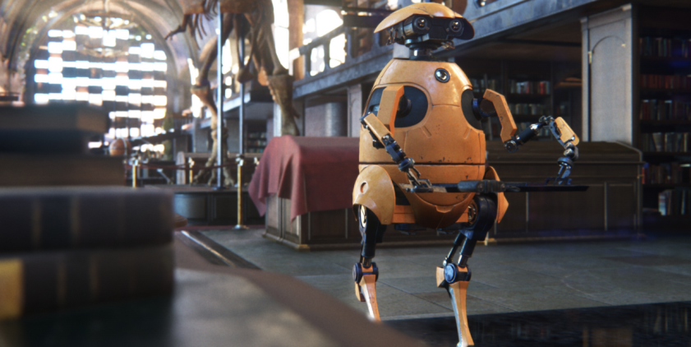
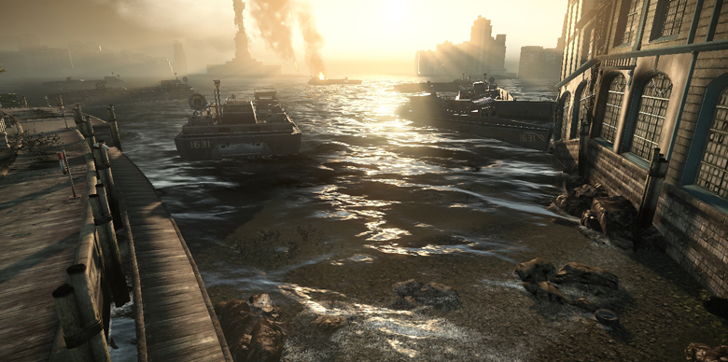
Graphics for Games CPI 411

Slide 2
Today's Contents
Solution of Lab#2 (Demo)
Lighting
Quiz#2 (2D/3D Transformation & Viewing)

Slide 3
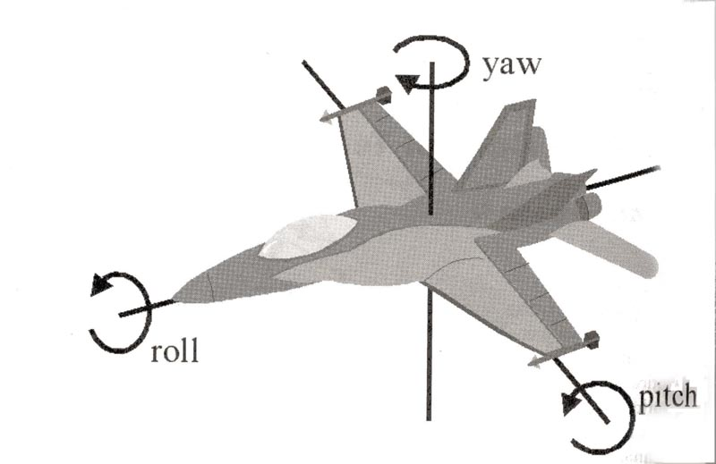
Review: World Matrix (in XNA)
Read the article below
http://rbwhitaker.wikidot.com/basic-matrices
Matrix modelWorldMatrix = Matrix.CreateScale(scale) * Matrix.CreateRotationX(rotations.X) * Matrix.CreateRotationY(rotations.Y) * Matrix.CreateRotationZ(rotations.Z) * Matrix.CreateTranslation(position);

Slide 4

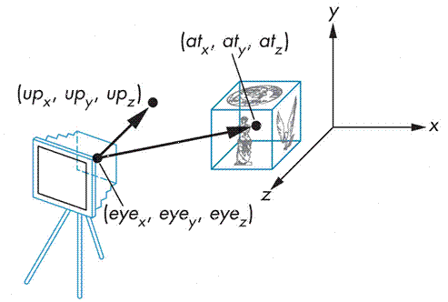
Review: View Matrix (in XNA)
Read the article below
http://gsteph.blogspot.com/2012/05/world-view-and-projection-matrix.html
Matrix view = Matrix.CreateLookAt(
new Vector3 (eye.x, eye.y, eye.z),
new vector3 (at.x, at.y, at.z),
new Vector3 (up.x, up.y, up.z)
);

Slide 5
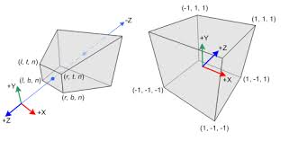
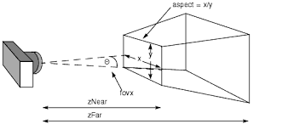
Review: Projection Matrix (in XNA)
Read the article below
http://relativity.net.au/gaming/java/ProjectionMatrix.html
Matrix projection =Matrix.CreatePerspectiveFieldOfView(
FOV, Aspect, Nearest, Farthest);

Slide 6
Lighting

Slide 7
Contents
"Lighting and Lighting Models" explains the importance of lighting and introduces the concept of a lighting model.
"Implementing the Basic Per-Vertex Lighting Model" presents a simplified version of the lighting model used in OpenGL and Direct3D. This section also goes through a step-by-step implementation of this lighting model in a vertex program.
"Per-Fragment Lighting" describes the differences between per-vertex and per-fragment lighting and shows you how to implement per-fragment lighting.
"Creating a Lighting Function" explains how to create your own functions.
"Extending the Basic Model" describes several improvements to the basic lighting model, including texturing, attenuation, and spotlight effects. While explaining these improvements, we introduce several key Cg concepts, such as creating functions, arrays, and structures.

Slide 8
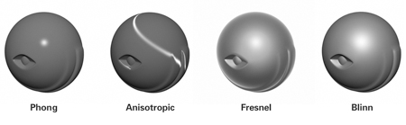
Lighting and Lighting Models
Understand the basic models such as Phong, Anisotropic, Fresnel, and Blinn
Understand the implementation of these model in HLSL
https://en.wikipedia.org/wiki/Anisotropic_filtering

Slide 9

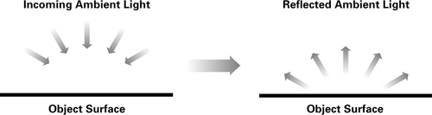
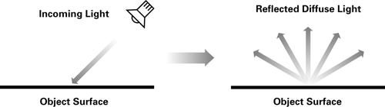

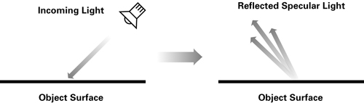

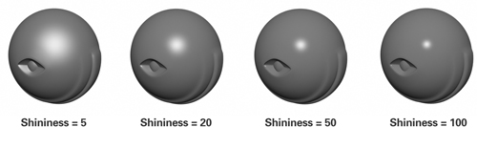
Implementing the Basic Per-Vertex Lighting Model
Ambient
Diffuse
Specular
Shininess

Slide 10
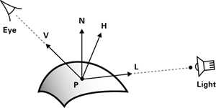
Physics for Lighting
N is the normalized surface normal,
V is the normalized vector toward the viewpoint,
L is the normalized vector toward the light source,
H is the normalized vector that is halfway between V and L,
P is the point being shaded, and
facing is 1 if N · L is greater than 0, and 0 otherwise.

Slide 11
Data for the Graphics Pipeline
Parameter | Variable Name | Type | Category
GEOMETRIC PARAMETERS
Object-space vertex position | position | float4 | Varying
Object-space vertex normal | normal | float3 | Varying
Concatenated modelview and projection matrices | modelViewProj | float4x4 | Uniform
Object-space light position | lightPosition | float3 | Uniform
Object-space eye position | eyePosition | float3 | Uniform
LIGHT PARAMETERS
Light color | lightColor | float3 | Uniform
Global ambient color | globalAmbient | float3 | Uniform
MATERIAL PARAMETERS
Emissive reflectance | Ke | float3 | Uniform
Ambient reflectance | Ka | float3 | Uniform
Diffuse reflectance | Kd | float3 | Uniform
Specular reflectance | Ks | float3 | Uniform
Shininess | shininess | float | Uniform

Slide 12
Useful Functions in HLSL
normalize(v) : Return a normalized version of vector v
dot(a, b): Returns the dot product of vectors a and b
max (a, b): Returns the maximum of a and b
pow(x, y): Returns x^{y}

Slide 13
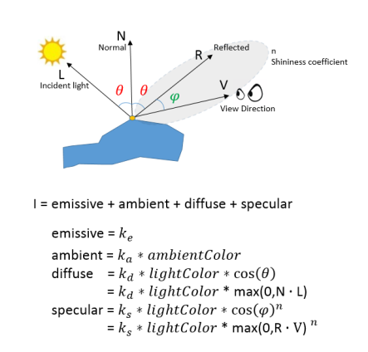
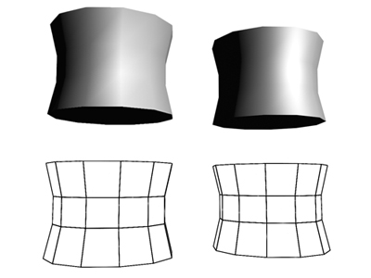
Per-Fragment Lighting
Per-vertex vs. Per-fragment lights
http://in2gpu.com/2014/06/19/lighting-vertex-fragment-shader/

Slide 14
Next
Quiz#2: 2D/3D Transformation (10 minutes)
Reading Homework
Cg Tutorial Chapter 5
http://http.developer.nvidia.com/CgTutorial/cg_tutorial_chapter05.html
+ The articles posted in this slide
Lab #3 (Lighting Exercises) : Posted already!

